Slide 1
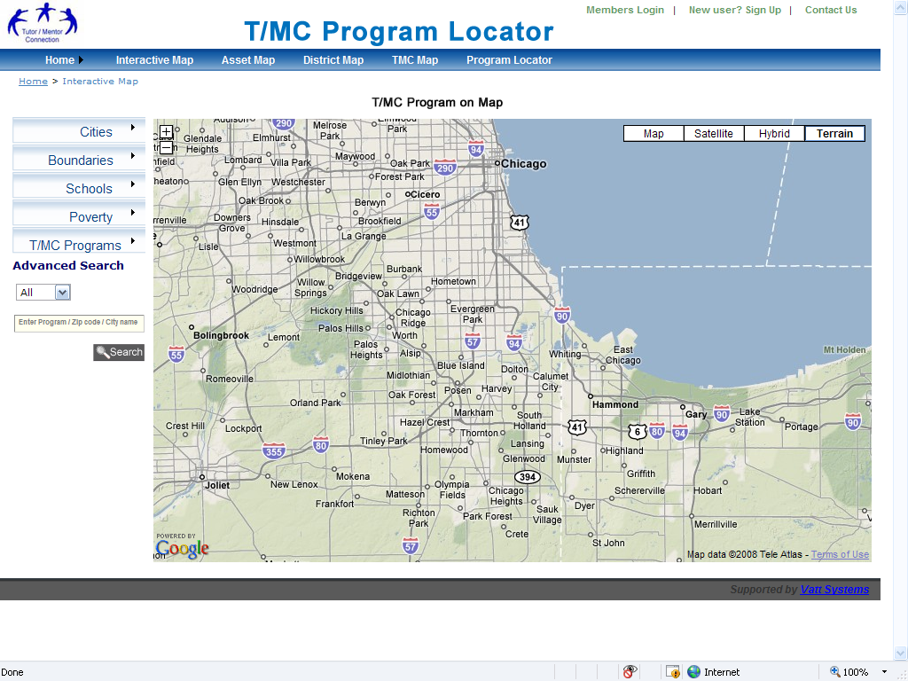
Secondary pages of T/MC site:
After looking at the secondary pages of the Program Locator, it seems to me that you have the categories that I’m looking for, but are not conveying the message I’m trying to convey. We have already created specific map stories showing political districts, news stories, or collaboration opportunities.
On these secondary pages I’d like to start with the story we’ve mapped, then let the viewer use the Interactive map to search to create map views of similar stories. Let me try to visualize what I am thinking about. I’m modeling my thinking on the Policy Link SAMPLE maps.
Asset maps
When viewer clicks on this link, they open a page showing four or five boxes each with a theme, and a map view that Illustrates that theme. Thus, for banks, show Bank of America. For faith groups, show catholic church
theme
Business
Faith Groups
Health Care
Universities
Bank of
America
Catholic
Church
Hospitals
Universities
When viewer clicks into the Bank Map screen, they go to the full map screen.
They see the choices from the interactive map (first page) and they see choices of other banks. Thus, they can look at only Bank of America, or this bank in combination with other banks, or other banks alone
This same thinking would repeat with churches, hospitals, universities.
Thus, we START their thinking of how to use this page by what example we show when they click to the page.
A) When this page opens, viewer should see four (or more) boxes, each with a map view already in them, and with a text box under them.
Text box
List of other banks and businesses we have mapped
B) When the visitor clicks on interactive version, they can choose to look at other banks, or other business categories.
C) They can create a view showing all the other options available
b

Slide 2
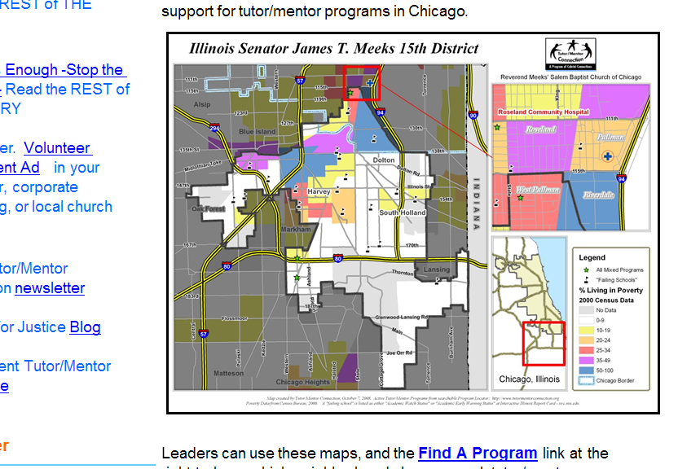
Secondary pages of T/MC site:
The DISTRICT map page would follow the same thinking
District maps
When viewer clicks on this link, they open a page showing four or five boxes each with a theme, and a map view that Illustrates that theme. Thus, for banks, show Bank of America. For faith groups, show catholic church
a
When viewer clicks into this page they see the 7th Congressional District, or another district, which we have mapped. The text box points to blogs where we have described how to use this map, or any other descriptive information we might choose.
When the open the map they get the full interactive size screen, with the choices from the interactive map (first page) and they see choices of other Districts.
When they click on a district, can the map highlight that district with a different color border, or shade?
This same thinking would repeat with the other districts being mapped.
Congress
St. Senate
St. Legislature
Chicago alderman wards
Text box explanation
b
Interactive map, and List of other districts

Slide 3
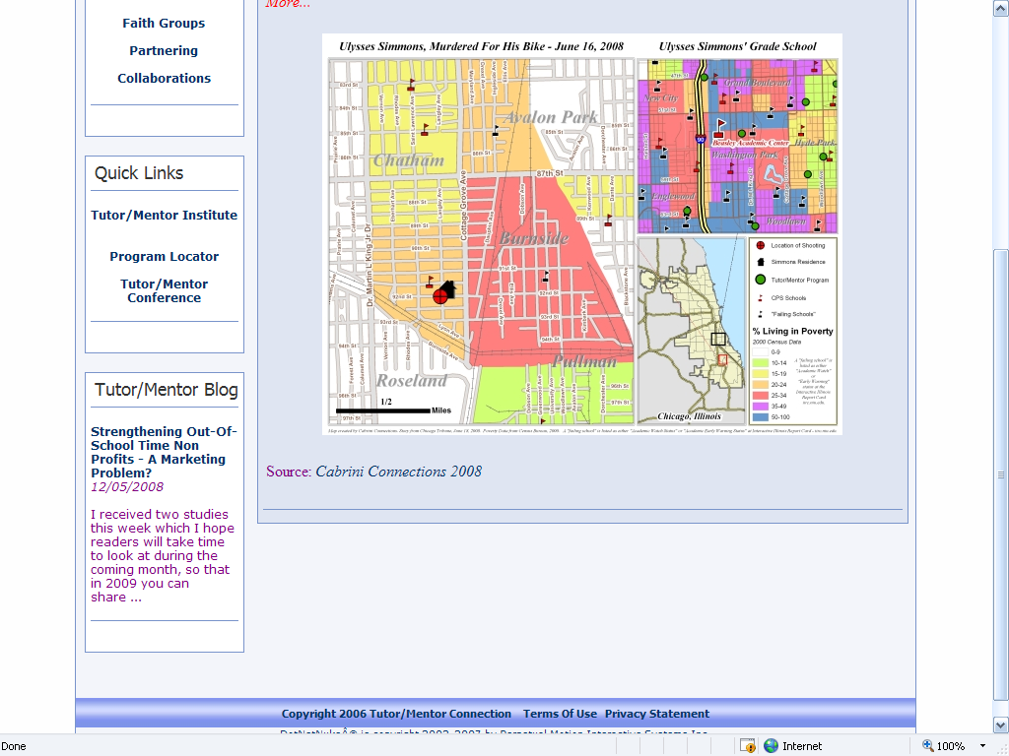
Change to section titled of T/MC Map:
The T/MC map page would follow the same thinking. We need a new name for this title that conveys the meaning of what people will find on this page. I’ve been using “REST OF STORY” Maps. Is this too long?
Rest of Story
When viewer clicks on this link, they open a page showing four or five boxes each with a theme, and a map view that Illustrates that theme. Thus, for banks, show Bank of America. For faith groups, show catholic church
This page is different because we’re showing stories we’ve mapped.
The feature story should always be the most recent story.
The map view will usually be of a small part of the city that we have mapped, but it could be the entire city, as we have mapped for the conference participation and the lend a hand grants.
The idea we want to convey is “This is where the news is focusing on because of violence, poor schools, or gangs.” Our map shows why this happens (poverty, poor schools, shootings, lack of tutor/mentor programs, etc.)
We’re telling the viewer they can change this if the contact one of the tutor/mentor programs in the area and offer help.
However, we’re also saying, they can search the interactive map, for other areas of the city with t he same problems, where tutor/kmentor programs also need help.
Violence
Schools
Networking
Capacity Building
Text box explanation
a
From each category, we should point to a list of other maps we’ve created.
This page might just have a set of thumbnails, with links to blog stories.
Once someone reads the story they are linked back to the interactive map, where they see the outline of the district we’ve mapped, but where they can also use the asset map and district map, to build collaborations that lead to more tutor/mentor programs.
b

Slide 4
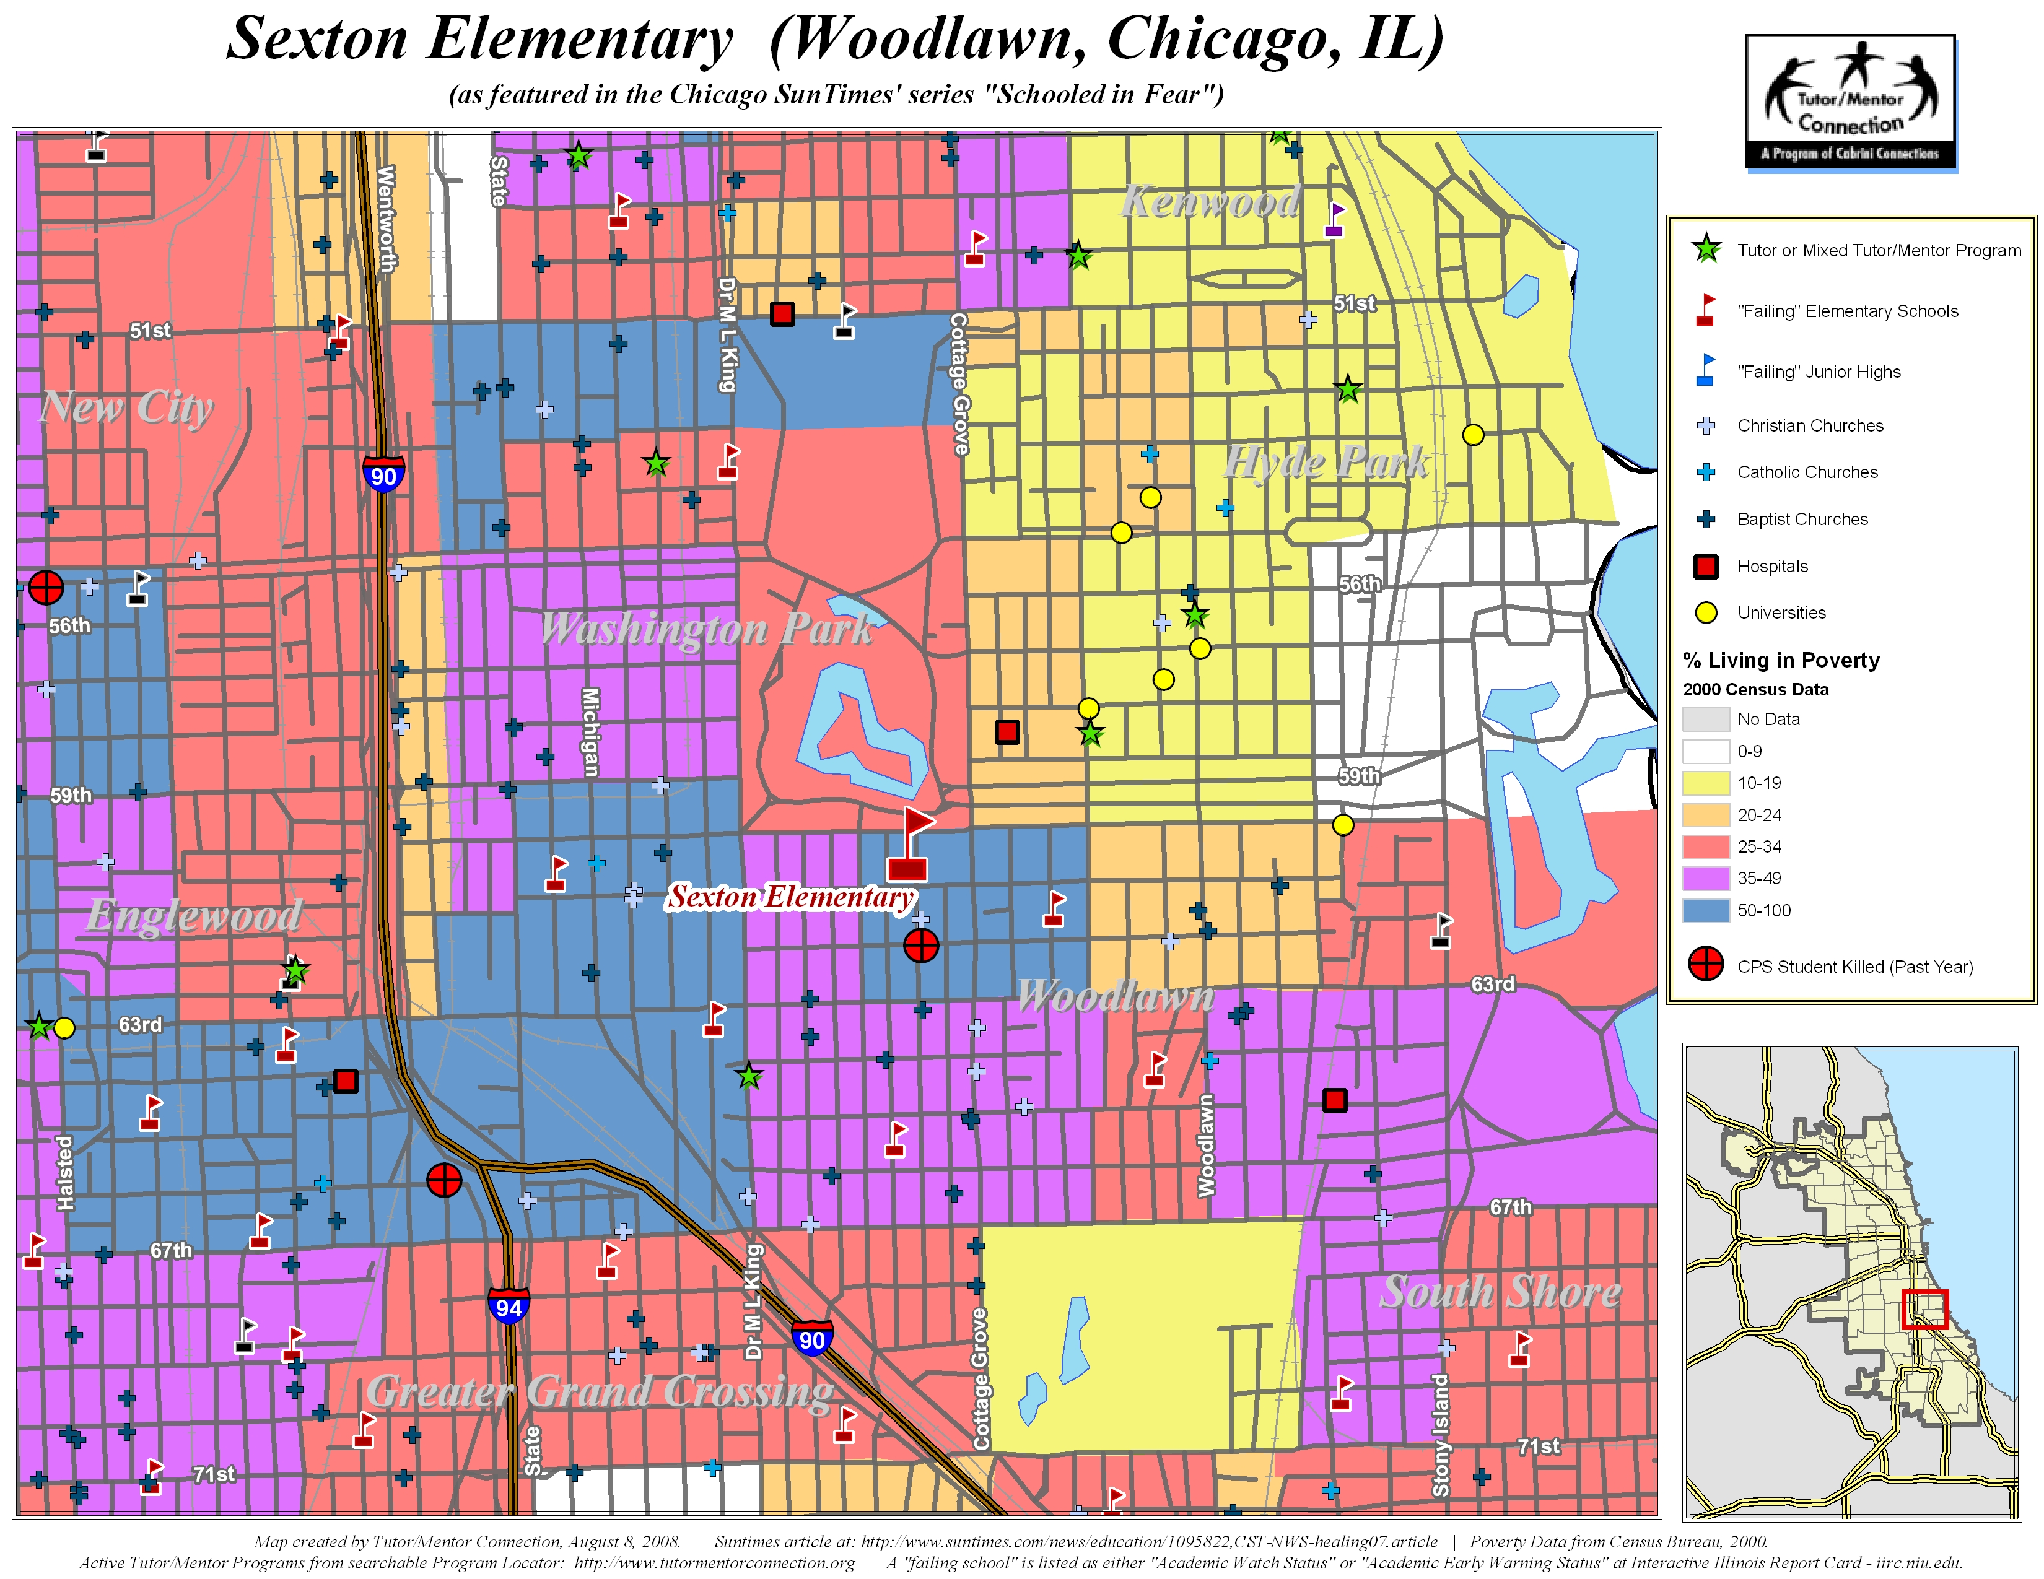
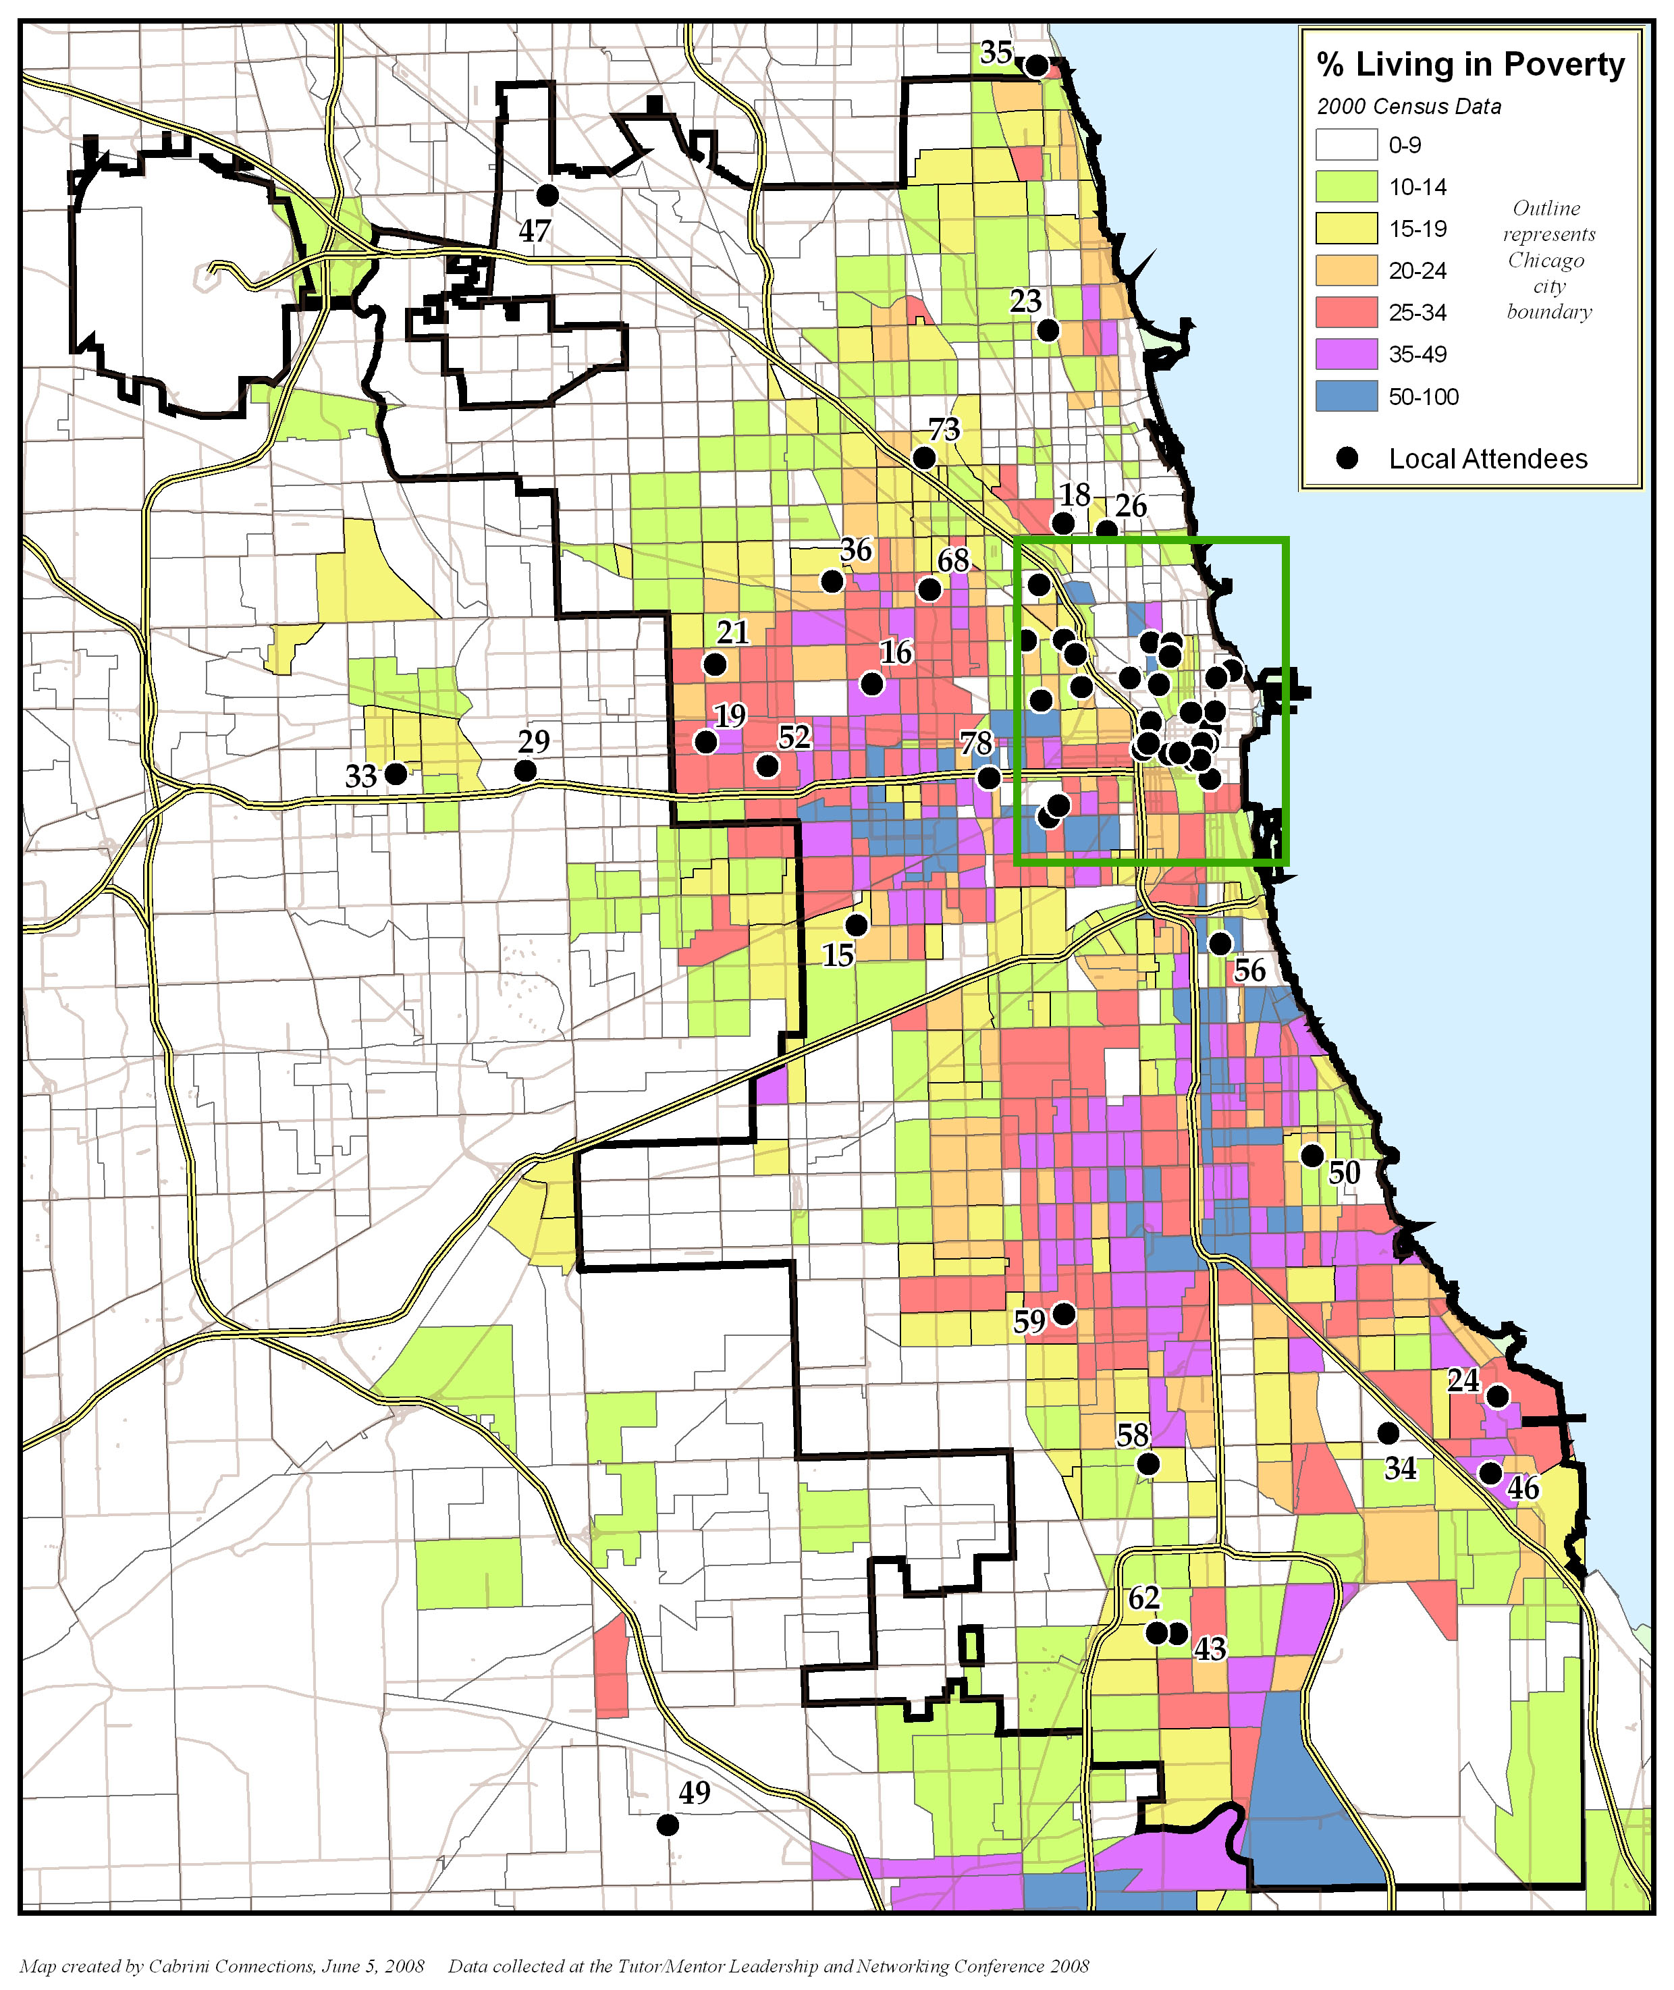
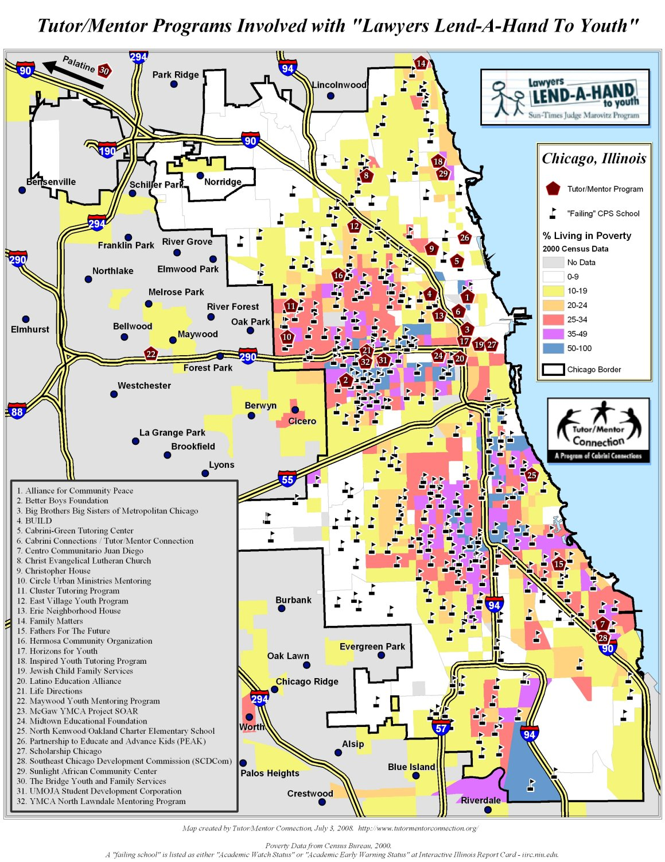
Rest of Story
The maps on this page were created by Tutor/Mentor Connection to focus attention on specific neighborhoods, following negative news stories, or supporting capacity building, networking and collaboration activities. Read the blog story for each map, and use the interactive features to build your own collaboration strategy.
Violence
Schools
Murdered for Bike, 6/16/08
Blog article at
http://mappingforjustice.blogspot.com/2008/06/ulysses-simmons-murdered-for-his-bike.html
Schooled In Fear, Sexton Elementary, 8/5/08
Blog article at
http://mappingforjustice.blogspot.com/2008/08/supplementary-maps-for-sun-times.html
Networking
Capacity Building
Nov 08 conference
Blog article at
http://tutormentor.blogspot.com/search/label/conference
2007 Lend A Hand Grants
Blog article at
http://tutormentor.blogspot.com/2008/02/lawyers-support-chicago-mentoring-with.html

